Slide 1

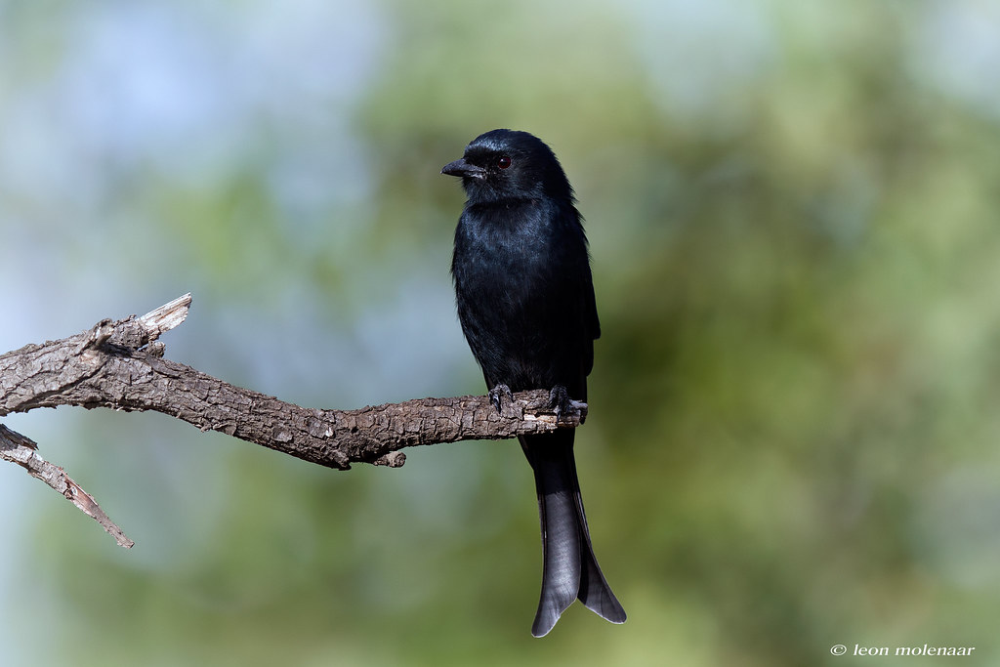


Radar Enabled Camera Trap
Designed For Behavioral Monitoring Of Fork-Tailed Drongos
Presented by Group 8

Slide 2
Introduction and Problem Statement
Ben Murphy is studying Southern Yellow-Billed Hornbills and Fork-tailed Drongos in the Kalahari desert.
He is researching the decline in breeding success of the Hornbills due to rising temperatures while the breeding success of the Drongos remains stable.
He needs a method to consistently capture footage of the Drongos for behavioural analysis, as his current techniques lack reliability.

Slide 3
Proposed Solution
Use multiple sensors to ensure reliability: PIR, mmWave, Acoustic, Weight.
Cost effective and reusable system.
Solar power and battery system for indefinite operation.
Wireless data retrieval to avoid climbing trees.

Slide 4

Powering The Camera Trap
Low-cost
Environmentally friendly
Battery powered
Ability to use solar panel input for power

Slide 5
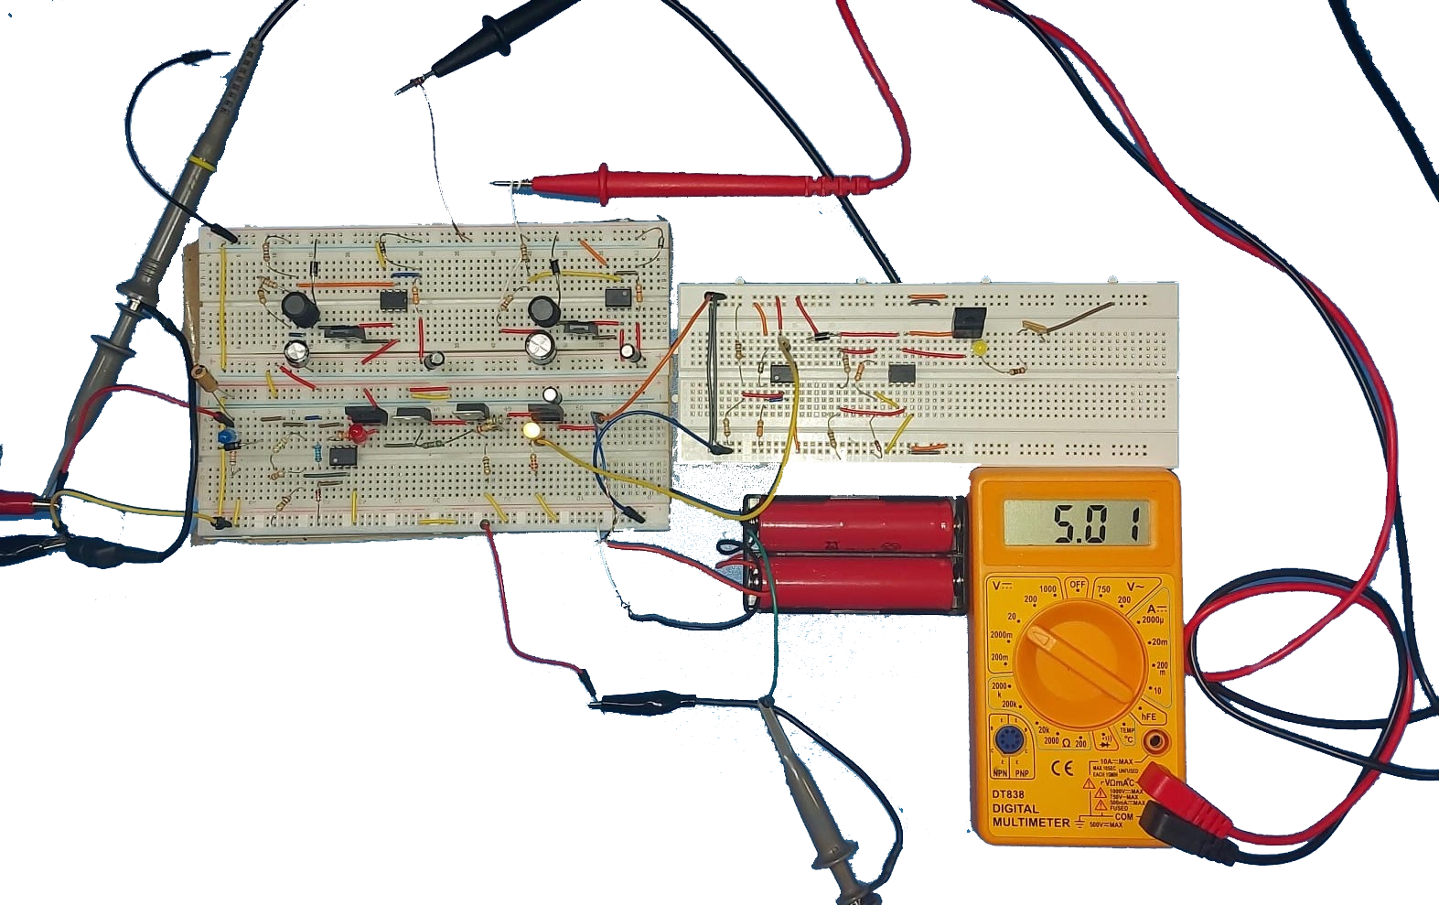

Power Management
Features:
Protection circuitry
Priority switching
Under-voltage
Over-voltage
Long battery life

Slide 6
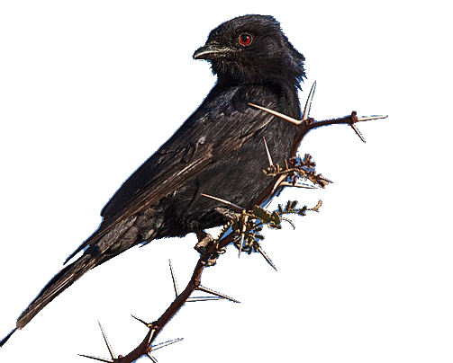
Future Enhancements
Optimise battery charging
Printed circuit board (PCB) transition
Protective system enclosure
Address voltage drop issue

Slide 7
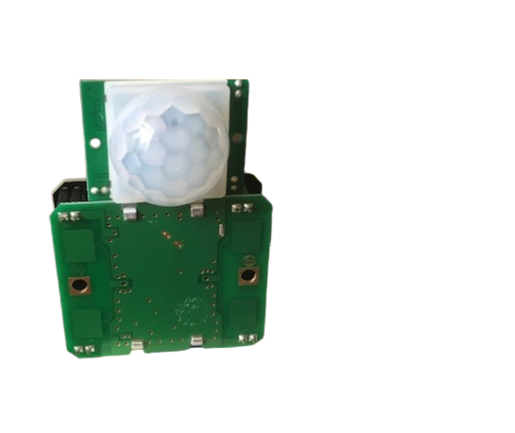
Sensing and System Triggering
Reduction in missed triggers
Improvement in low-light conditions
Radar and PIR Dual Sensing System

Slide 8

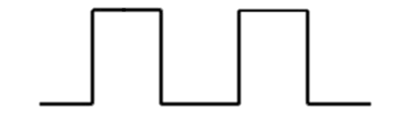

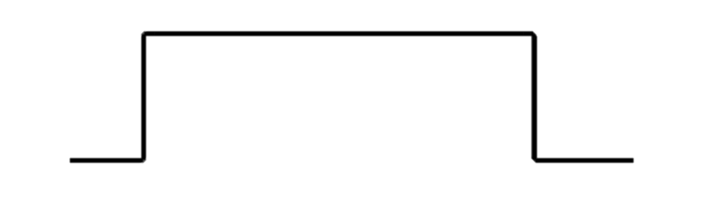


System Features and Performance
Adjustable Sensitivity
Multi-Trigger Handling
False Trigger Filtering
<50ms Trigger Event

Slide 9
Future Enhancement
In the field testing needed
Stationery object detection
Reduce radar power consumption

Slide 10
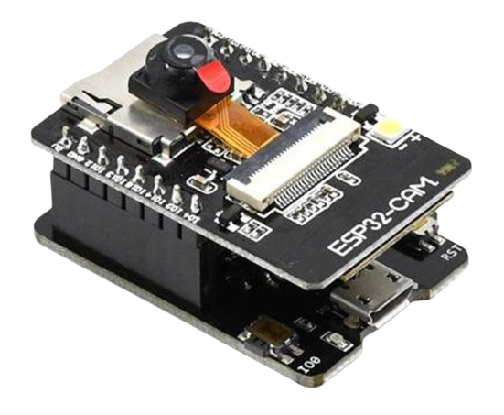
Camera and Footage Capture
Camera is a crucial decision of the final product
Needs to be cost effective, power efficient and have good quality
ESP32-Cam with OV5640

Slide 11
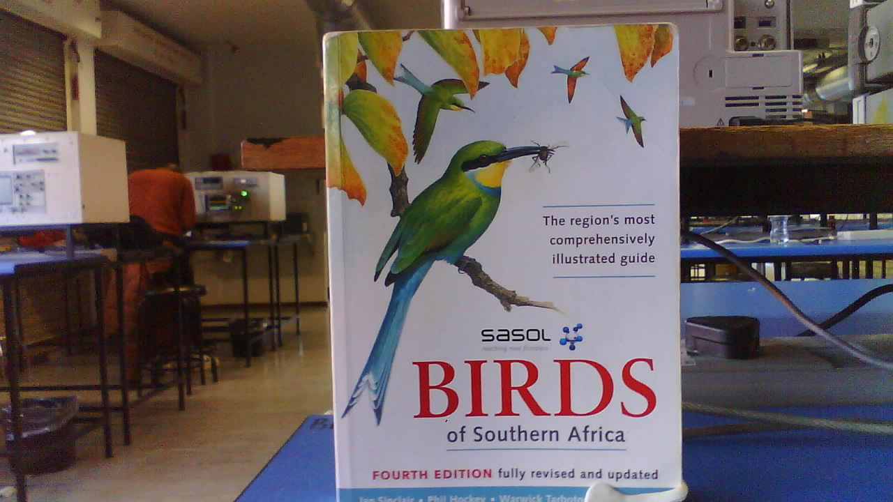
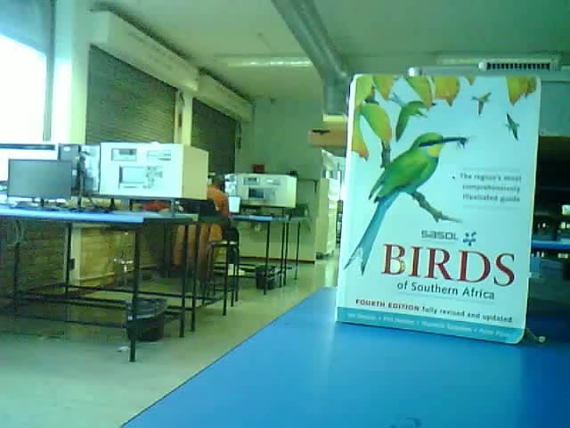
ESP32 and OV5640
Low cost of R300
Starts recoding in < 1 second
High quality 2560 x 1920p
Records at 12fps 480p
Adjustable focal point
Poor performance in low light

Slide 12
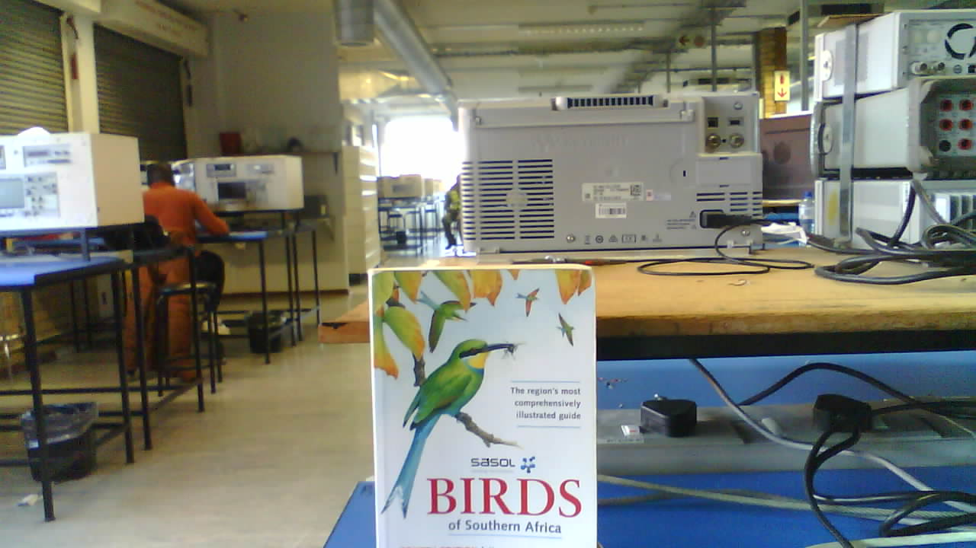
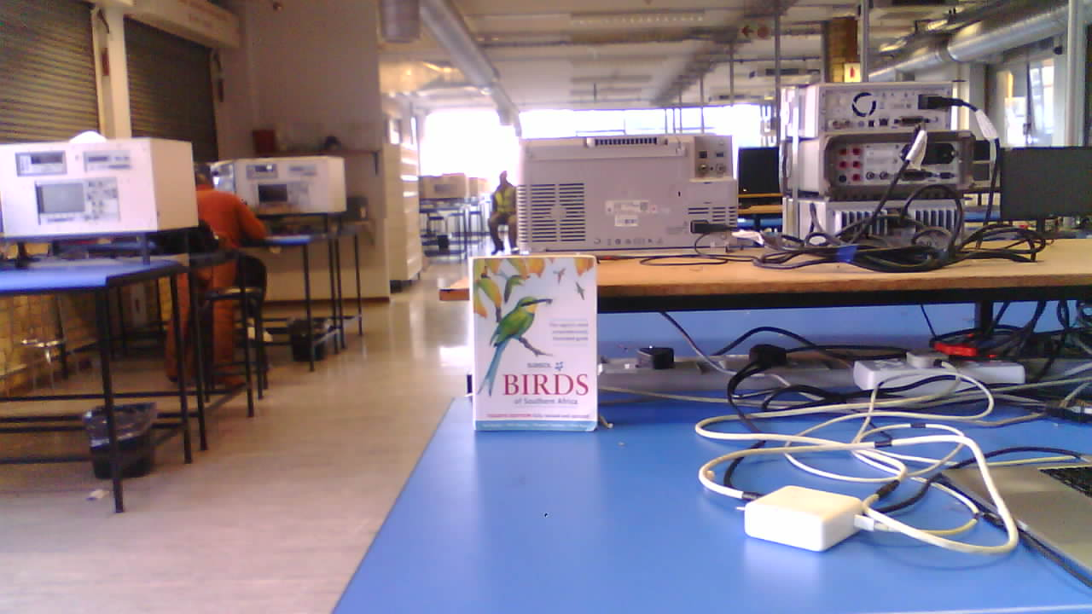
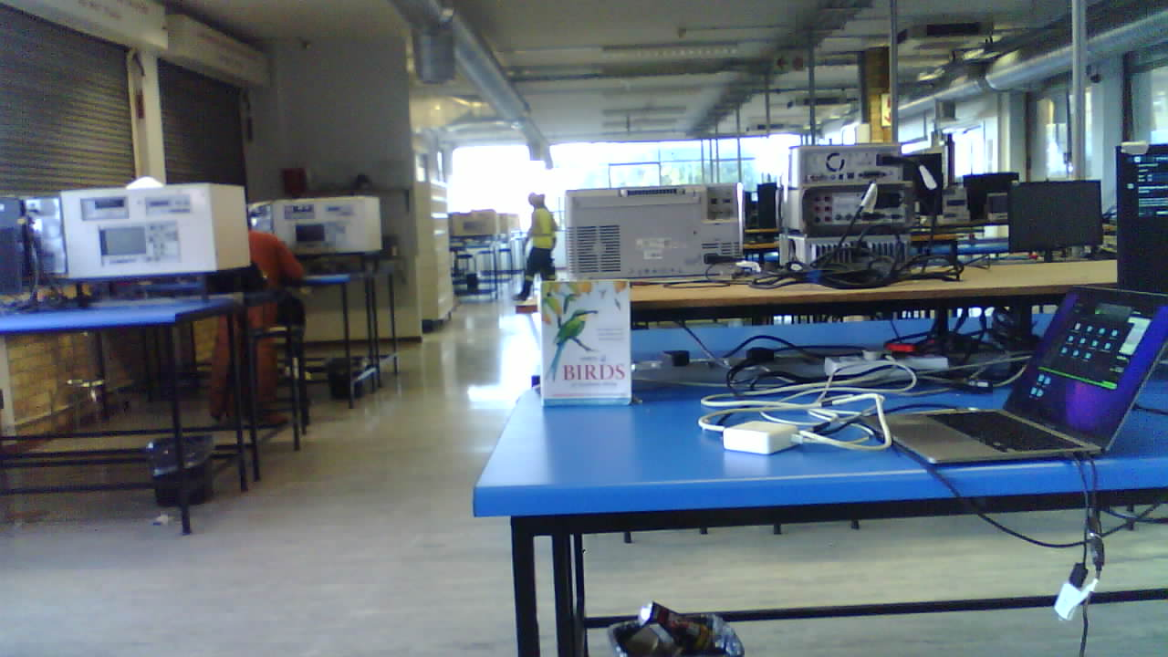
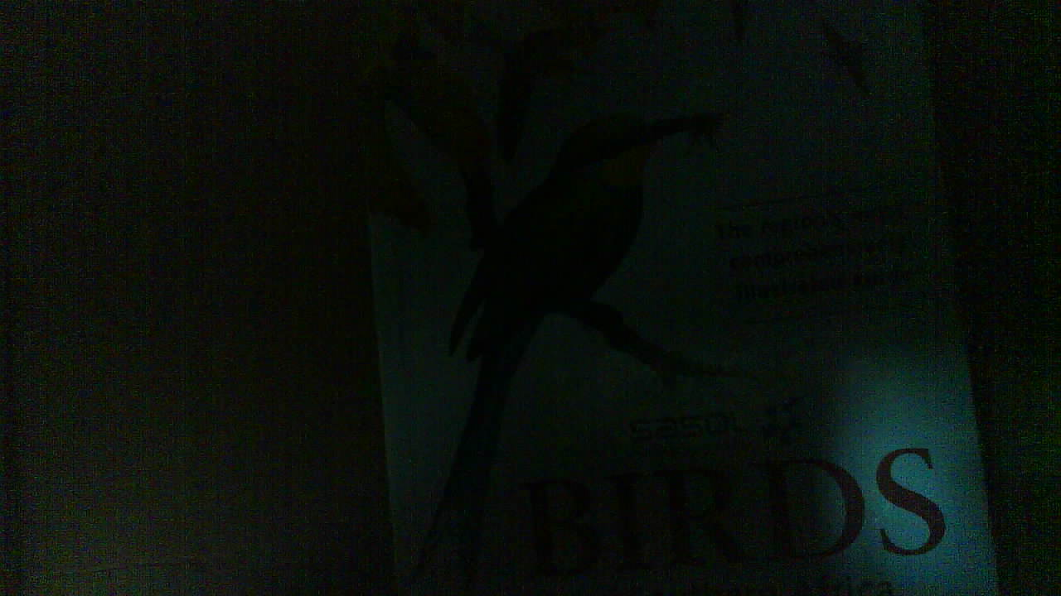
Close (30 cm)
Medium (1m)
Far (3m)
Low light

Slide 13
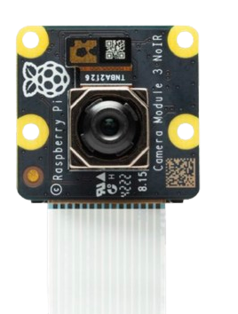
Optimizations and Enhancements
Raspberry Pi paired with the 12MP Pi Camera Module V3 with Motorized PDAF.
Machine learning algorithm to estimate the presence of a bird

Slide 14
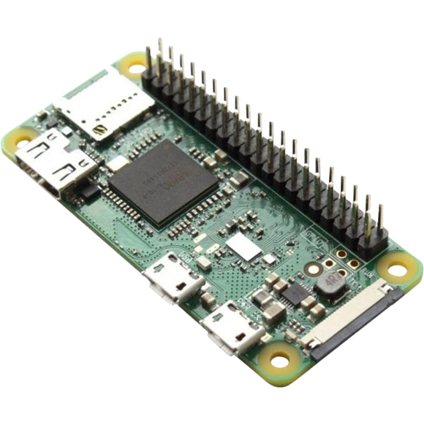
Front End System
Data Storage – Store large video files
Data Processing – Creating Usable Statistics
Ease of access to data – download files wirelessly
Raspberry Pi local host web server ticks these boxes

Slide 15
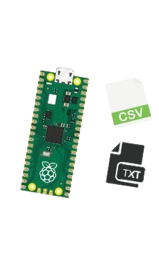
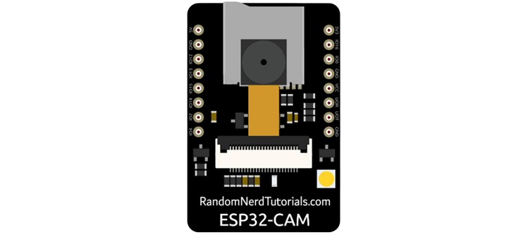
Wireless Data Storage and Processing
Files are wirelessly transferred from the camera system to the storage system.
These files include pictures, videos and text files containing data
Data files are processed to give useful statistics, using a combination of scripts.

Slide 16
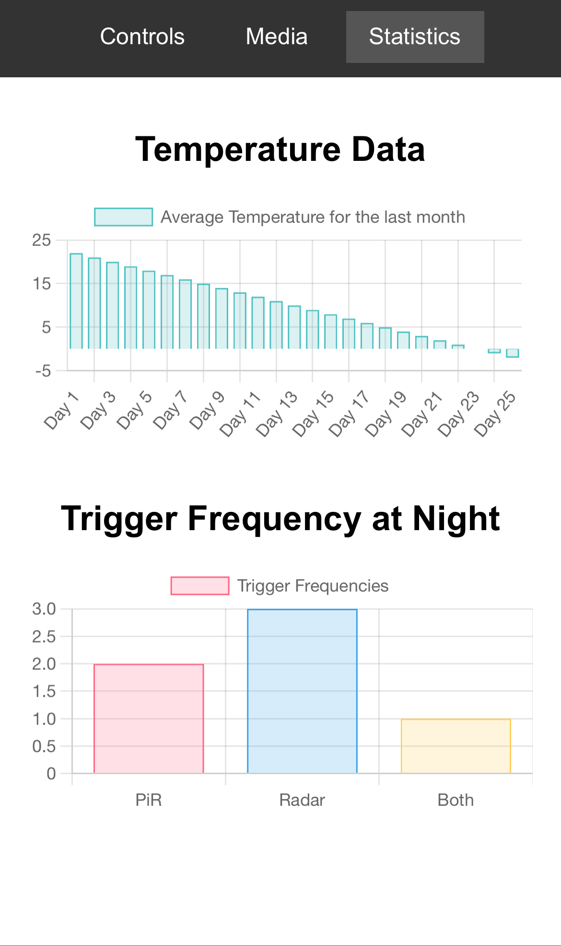
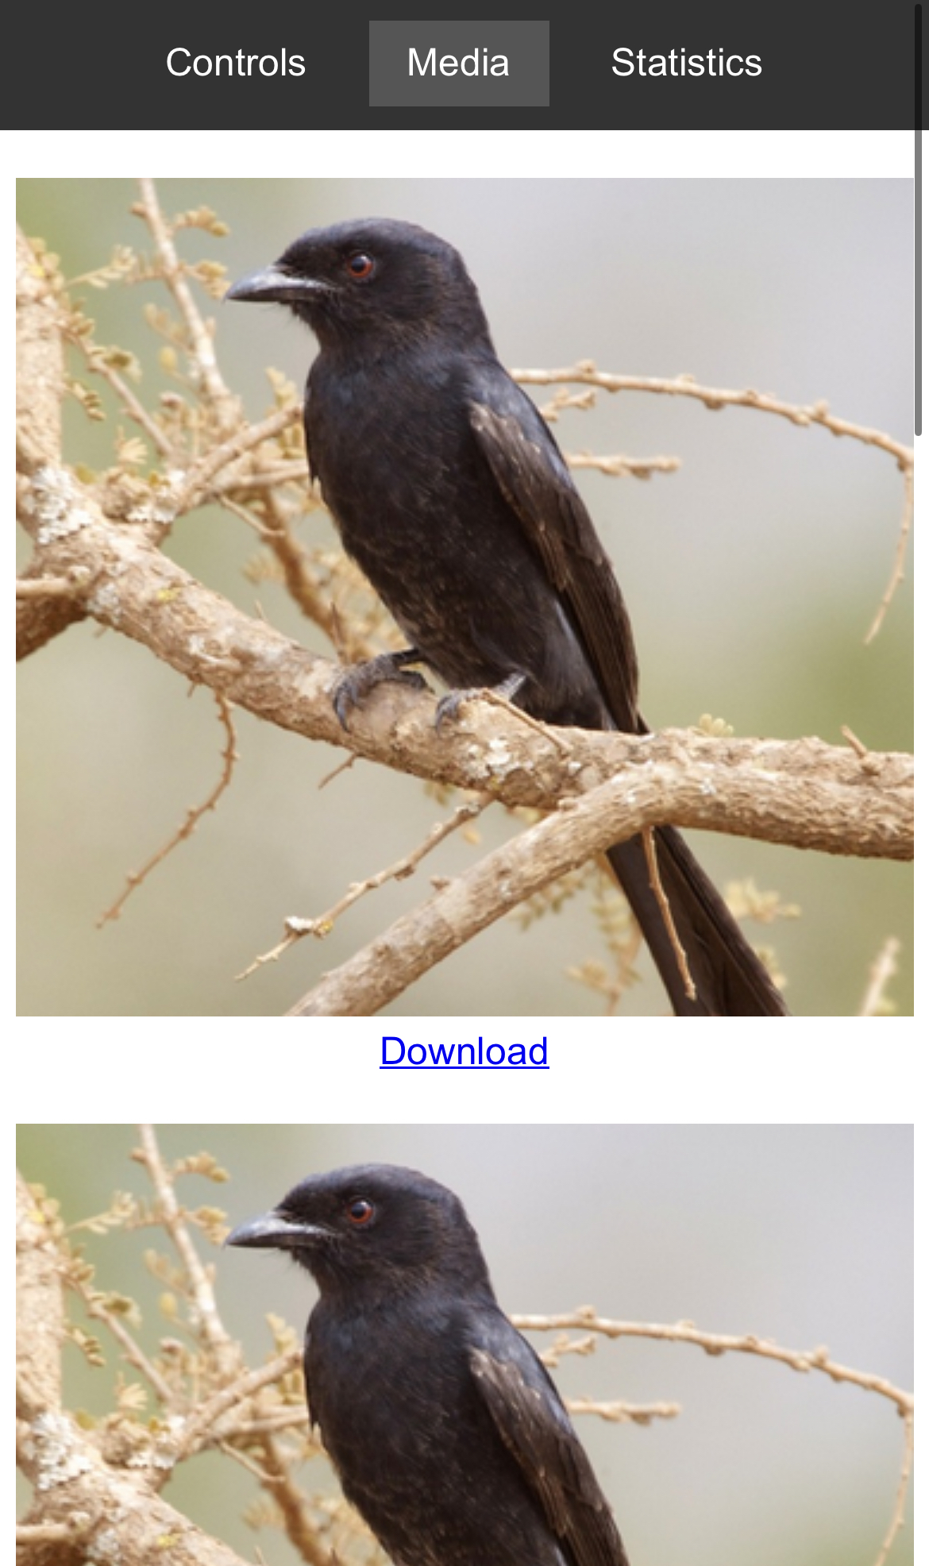
Website and Data Downloading
Connects via a Wi-Fi hotspot
Allows system interaction
View and Download picture and video files wirelessly (No more climbing trees)
View Graphs with useful statistics
View system analytics (Remaining storage, etc)

Slide 17
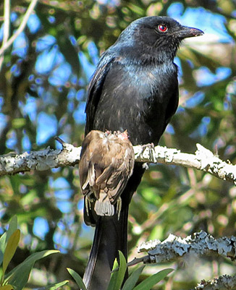
Conclusion
Successfully proved multiple concepts:
Multi sensor triggering
Footage capture and storage
Solar power and power management
Wireless user-friendly interface
Further refinements and enhancements outlined for next iteration.
Camera trap housing needs to be developed.

